Slide 2
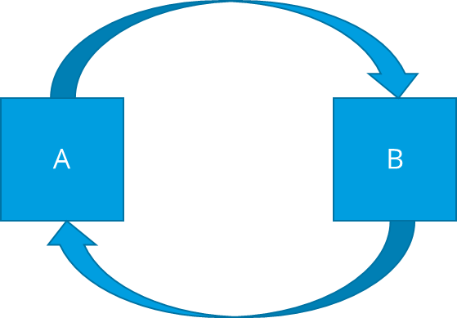
Disclaimer
This course is for you. Don’t hesitate to ask us!
Many of you will have questions and we can’t answer all of them instantaneously, please respect that.
The scope of the course is to give you an overview to modern Machine Learning/Deep Learning and that you are able to build some of the most important architectures in your own. We will try to skip heavy math but we can’t really leave out everything. Some things will be hard to explain since you need some domain knowledge from Computer Science, but take your time and think about it!
Sometimes you require knowledge of A to understand B and vice versa! → Try keep going!
To help you to get over this obstacle, course will consist of lectures and exercises which will also serve as a kind of proof.

Slide 3
Schedule
Monday
Introduction
1.1 HPC and GIT
1.2 Jupyter Notebooks
--- 1. Exercise ---
2. Python Basics
--- 2. Exercise: Python Basics ---
3. Neural Networks with Keras
3.1 Keras Basics
Tuesday
Convolutional Neuronal
Networks
1.1 HPC & Setup
--- 1. Exercise: Setup ---
Wednesday
Thursday
Do it yourself! Hackday!

Slide 4
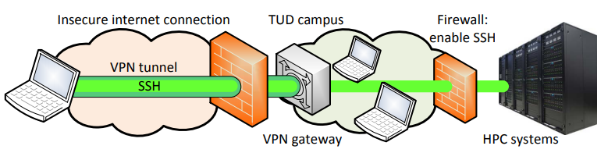
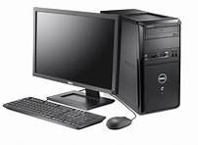
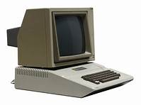
High Performance Computing
Through this course we will need compute power that could exceed the limitations of your PC/Laptop at home.
To run everything smoothly we are lucky to be supported by the TU Dresden Supercomputer TAURUS. This so called Hight Performance Computing (HPC) System is not accessible to public use and can only be used from the inside of TU Dresden Network
HPC Cluster
Your PC
Slurm System
= 8 CPU, 1-2 GPU
Node
requesting compute power
Checking for available resource
Free
Occupied

Slide 5
High Performance Computing
Through this course we will need compute power that could exceed the limitations of your PC/Laptop at home.
To run everything smoothly we are lucky to be supported by the TU Dresden Supercomputer TAURUS. This so called Hight Performance Computing (HPC) System is not accessible to public use and can only be used from the inside of TU Dresden Network
Slurm will allocate the resources requested by you without checking for sanity.
(If you need more request more. But be humble!)
HPC Cluster
Your PC
Slurm System
= 8 CPU, 1 GPU
Node
requesting compute power
Checking for available resource
Free
Occupied

Slide 6

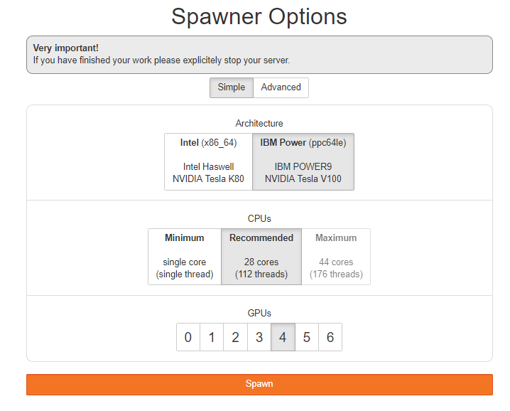
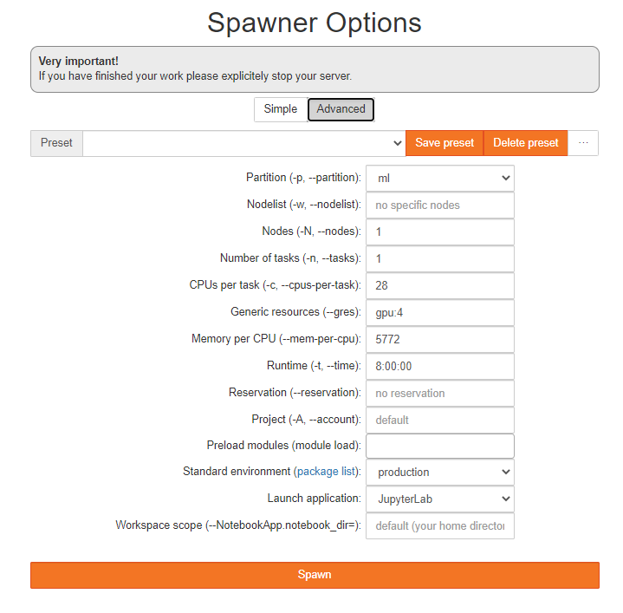



How to connect to HPC through the course
Make your you are connecting from the secure network within TU Dresden!
Go to your browser and visit:
https://taurus.hrsk.tu-dresden.de/jupyter
If you are within the TU network you can click on the button to enter this screen
Click
8
gpu:1
Check
Wait
„Reservation Code Name“
Click

Slide 7
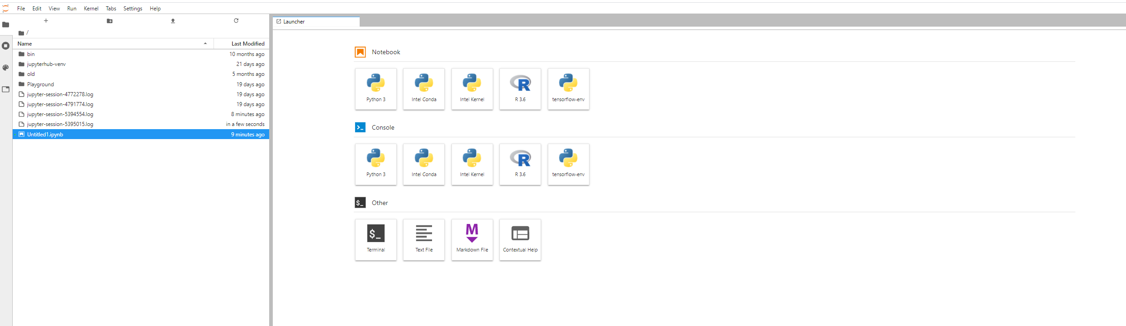

How to connect to HPC through the course
This is your „home“ screen for Jupyter on the HPC
Your screen will look a little different but don‘t worry!
YES! ☺

Slide 8
your current folder name
your current „tab“
Jupyter Hub
← … means „home“
All your folders
(this will probably be empty)
All the programs alredy installed for you
The Jupyter Hub is GUI on top of the Linux running on the HPC, which is accessible by the comand line. (don‘t worry we will only touch this in a single case)

Slide 9

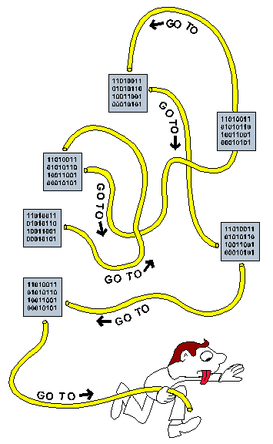
GitHub
We did prepare your materials to be downloaded via GitHub (Microsoft)
Github is an online code shareing platform which is very pupular in Computer Science (especially in ML)
Using a „Git“ is a very helpful tool in programing alone and with colaborateurs because of his version controll. (Coding a giant project with many collegues can end in a codemess)
Unfortunatly we dont have the time to introduce you to git in this course. But we encurage you to learn using it from one of the many very good resources already out in the internet.
For the sake of simplicity we just show you how to download an existing project (our material) from the github server to your HPC local folder.
Git is already installed for you in the Taurus! ☺

Slide 10
How to material with Git?
Click
In the new terminal window write:
Press Enter

Slide 11
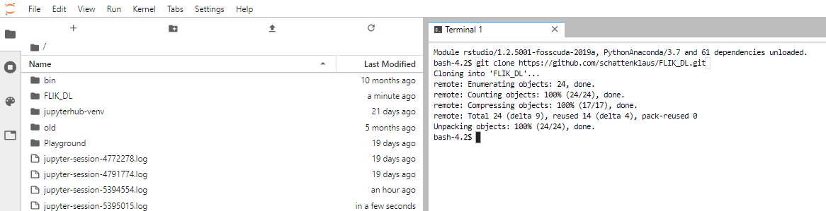
How to the course material with Git?
You should see the new „FLIK_DL“ folder in your directory → Click on it to excess all the course materials (our slides and notebooks on a daily basis)
Click
This is a local copy of our materials on your Taurus. If you unintentionally deleted something just redo the whole cloning process. You can now close the terminal window.

Slide 12
1. Exercise Setup your HPC resources and download the course material to your home folder via GIT!

Slide 13



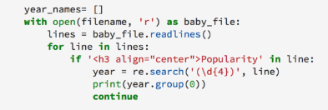
Python Basics
provides
You
Your Machine
uses
Instruction Set
Interpreter
translates
„101101 “
writes
Is read by
Very popular programming language in the scientific comunity!
Reason: easy understandeble code, free of charge and modular

Slide 14
Python Modules
Python basic

Slide 15
Keras Basics
The Keras software / hardware stack
Keras
Tensorflow
/Torch
Other important Libs e.g. Numpy
Python
CUDA/CuDnn
Blas/Eigen
GPU
CPU

